Slide 1
Deep Learning Classifier
Adviser：范志鵬 教授
Speaker：陳華倫

Slide 2
Outline
AI
Classifier introduction
Machine Learning
Deep Learning
Neural network
Convolution Neural network
Deep Neural network
How to train a classifier
Reference

Slide 3
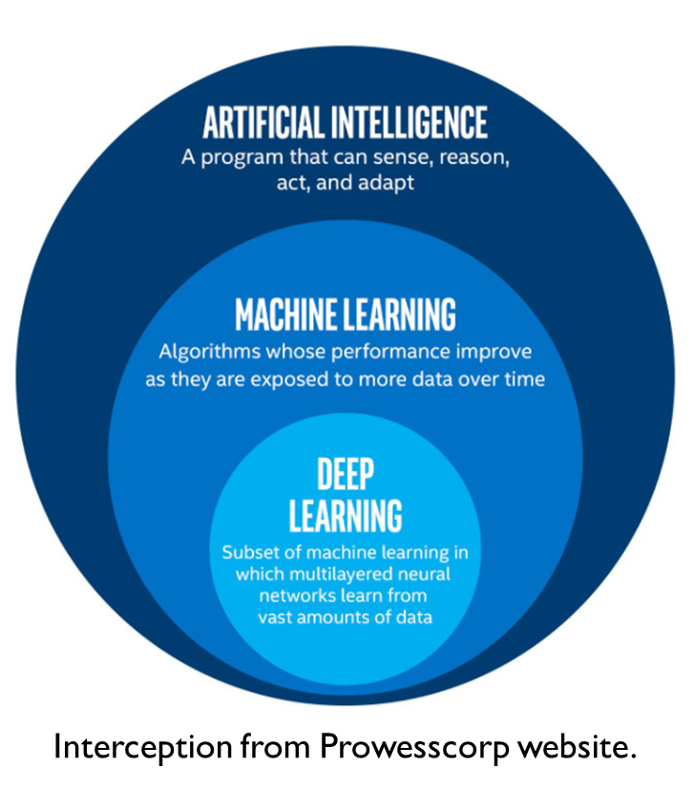
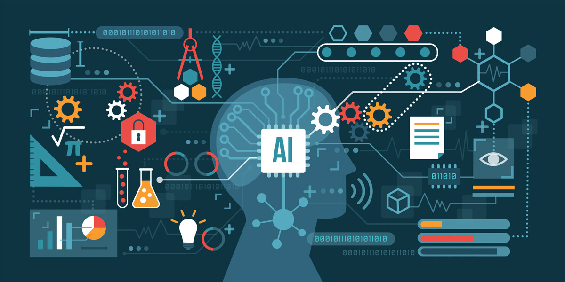
AI
The goal of AI is to simulate the human brain and use the computer’s eyes (camera), ears (microphone), mouth (speaker), hands, feet, and body (robots) to obtain information about the external world, and use this information to perform human-like intelligence.
Ref:https://aicloudinnovations.com/natural-language-processing-the-multi-faceted/

Slide 4
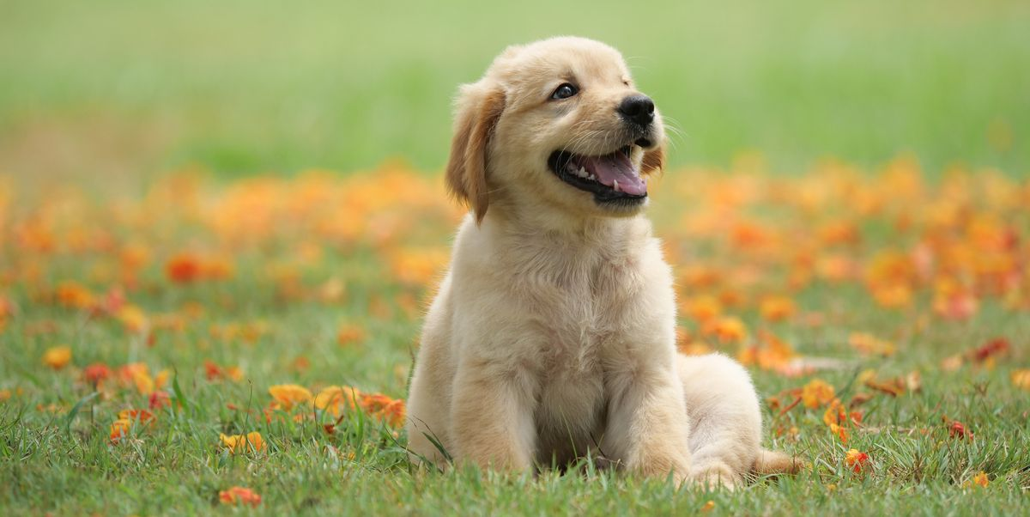
Classifier introduction
The purpose of a Classifier is to know what a target is.
EX: you can train a classifier and feed it a photo to know which class the image is.
Dog
Classifier
Frog
Cat
Ref: https://medium.com/@troy801125/machine-learning-%E4%BA%BA%E5%B7%A5%E6%99%BA%E6%85%A7%E5%92%8C%E6%A9
%9F%E5%99%A8%E5%AD%B8%E7%BF%92%E6%98%AF%E4%BB%80%E9%BA%BC-49a6ba41ab3e

Slide 5
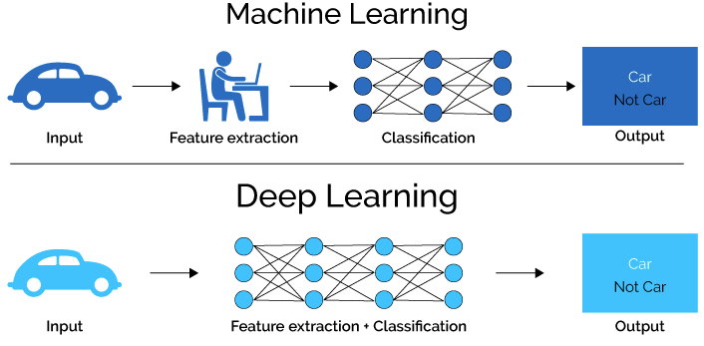
Classifier introduction
There are two main ways to make a classifier.
Machine Learning
Deep Learning
Ref: https://makerpro.cc/2019/05/introduction-to-ai/

Slide 6
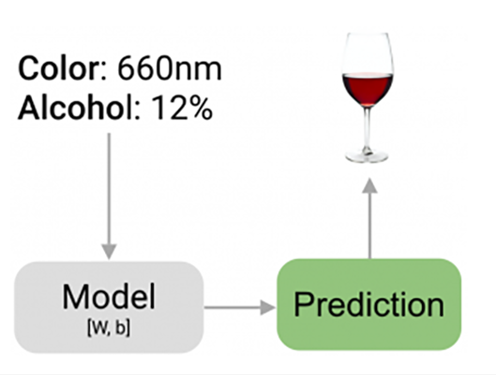
Machine Learning
Machine learning is an integral part of AI. So what exactly is ML? It is the ability to learn from previous data and perform operations to predict behavior. ML teaches machines to make decisions in situations they have never seen before.
Features
Ref: https://mile.cloud/zh/resources/blog/184/%E7%82%BA%E4%BB%80%E9%BA%BC%E6%A9%9F%E5%99%A8%E5%AD%
B8%E7%BF%92%EF%BC%88Machine%20Learning%EF%BC%89%E6%9C%83%E5%A4%AF%E7%BF%BB%E5%A4%A9%EF%BC%9F%E4%BD%A0%E7%9C%
9F%E7%9A%84%E4%BA%86%E8%A7%A3%E5%AE%83%E7%9A%84%E9%81%8B%E4%BD%9C%E6%96%B9%E5%BC%8F%E5%97%8E%EF%BC%9F

Slide 7

Machine Learning
In feature extraction, it is necessary to manually mark the features and convert the features into code or vector form, and then process them through a machine learning model, and finally get the prediction result.
Ref: https://makerpro.cc/2019/05/introduction-to-ai/

Slide 8
Machine Learning
There are three ways to learn the Machine Learning
Machine Learning
Supervised Learning
Unsupervised Learning
Clustering
Classification
Regression
Reinforcement Learning
Q-Learning

Slide 9
Machine Learning
Supervised Learning
Learn a model from a given training data set. When new data comes,
you can predict the result based on this model. The targets in the training set are
labeled by people.
Unsupervised Learning
there is no complete and clean labelled dataset in unsupervised learning. Unsupervised learning is self-organized learning. Its main aim is to explore the underlying patterns and predicts the output

Slide 10
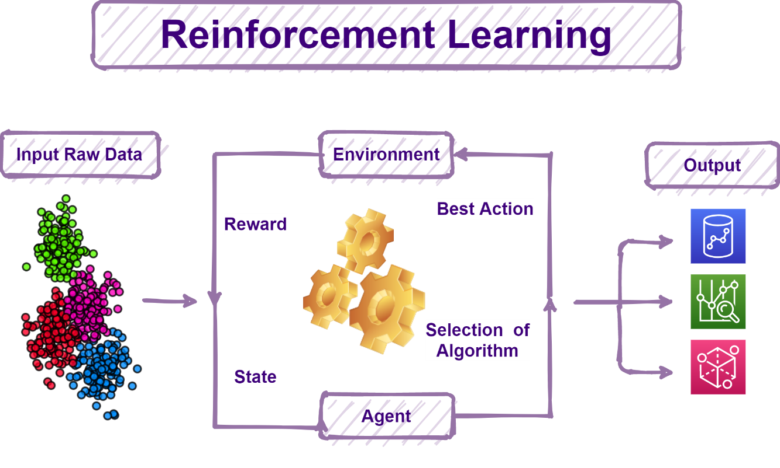
Machine Learning
Reinforcement Learning
It is neither based on supervised learning nor unsupervised learning. Moreover, here the algorithms learn to react to an environment on their own
Ref: https://www.inwinstack.com/blog-en/blog_ai-en/6262/

Slide 11
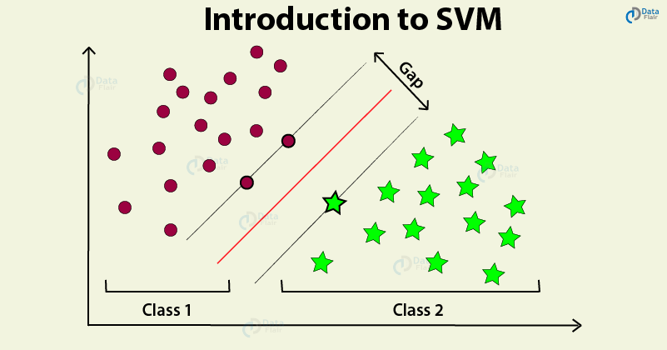
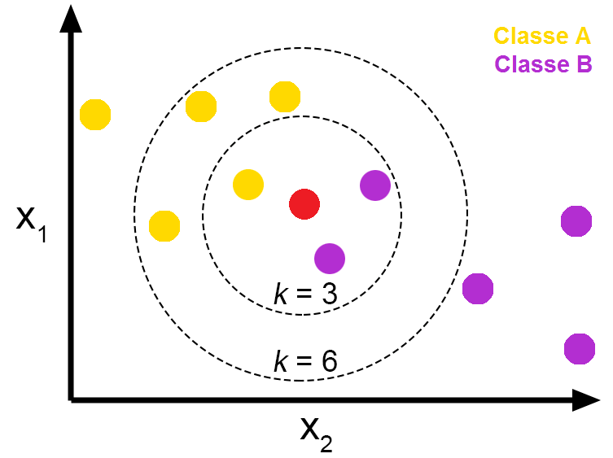
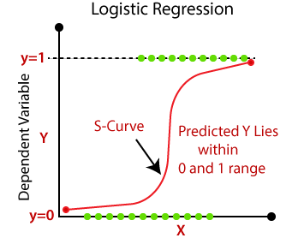
Machine Learning
Common ML Algorithm
SVM
KNN
Logistic Regression
SVM
Logistic Regression
KNN
Ref: https://data-flair.training/blogs/svm-support-vector-machine-tutorial/
https://towardsdatascience.com/knn-k-nearest-neighbors-1-a4707b24bd1d
https://www.javatpoint.com/linear-regression-vs-logistic-regression-in-machine-learning

Slide 12
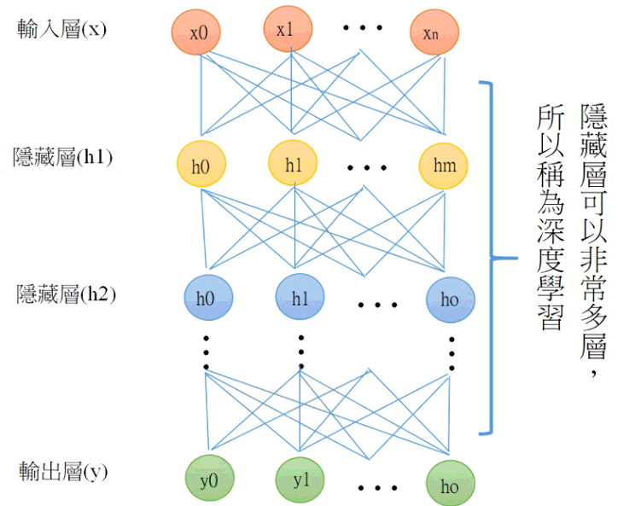
Deep Learning
Deep learning is especially used in the fields of visual recognition, speech recognition, natural language processing, biomedicine, etc., and has achieved very good results.
CNN
DNN
RNN
Ref: http://tensorflowkeras.blogspot.com/2017/06/blog-post_15.html

Slide 13
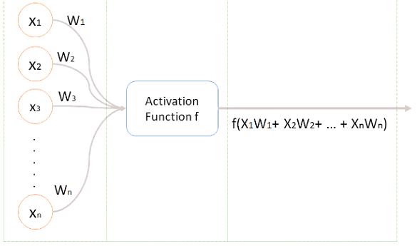
Neural network
Neural network is the main component that constitutes the so-called "Deep learning
Feedforward Neural Networks
Convolutional Neural Networks
Recursive Neural Networks
Recurrent Neural Networks
Neural
Ref: https://chtseng.wordpress.com/2017/07/24/neural-networks-%E4%B8%80/

Slide 14
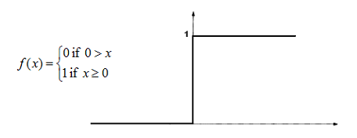
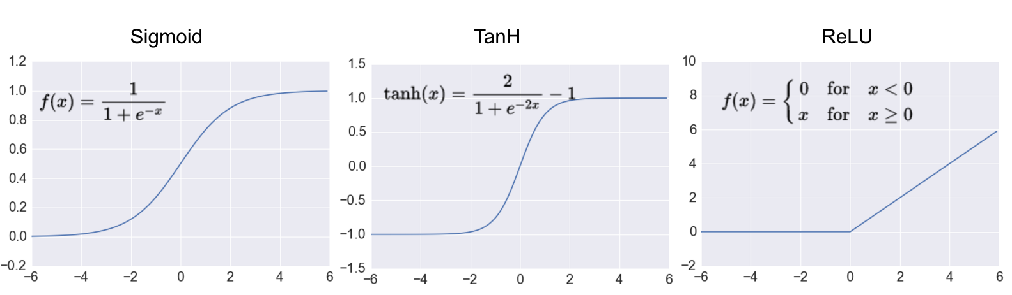
Neural network
Activation function
Step function
Sigmoid function
Tanh function
ReLU function
Ref: https://chtseng.wordpress.com/2017/07/24/neural-networks-%E4%B8%80/

Slide 15
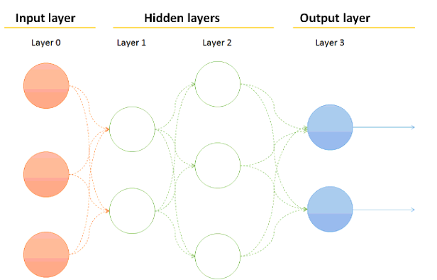
Neural network
Since a single neuron can only handle linear binary classification, if you want to deal with non-linear problems, you must use a multi-layer perceptron architecture (that is, a neural network)
Ref: https://chtseng.wordpress.com/2017/07/24/neural-networks-%E4%B8%80/

Slide 16
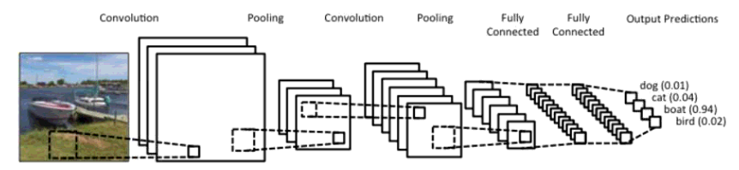
CNN
CNN is a class of deep neural networks(DNN) which is most commonly applied to analyzing visual imagery.
Classifier
Ref: https://ujjwalkarn.me/2016/08/11/intuitive-explanation-convnets/

Slide 17
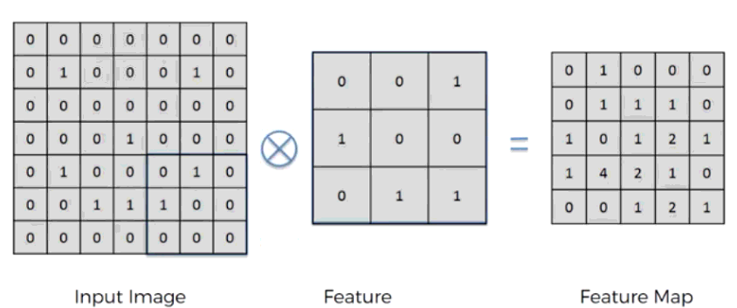
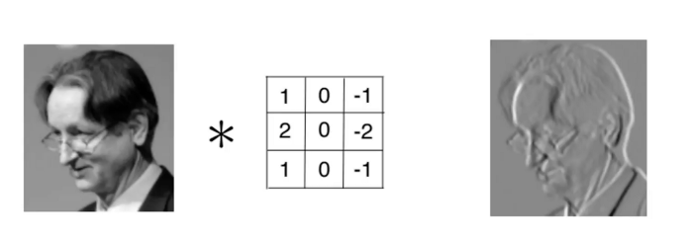
CNN
The convolution operation is to get the features in the picture.
Stride: 1
Kernel size: 3 x 3
Example
Ref: https://medium.com/jameslearningnote/%E8%B3%87%E6%96%99%E5%88%86%E6%9E%90-%E6%A9%9F%E5%99%A8%E5%AD%B8%E7%BF%92-%E7%AC%AC5-1%E8
%AC%9B-%E5%8D%B7%E7%A9%8D%E7%A5%9E%E7%B6%93%E7%B6%B2%E7%B5%A1%E4%BB%8B%E7%B4%B9-convolutional-neural-network-4f8249d65d4f

Slide 18
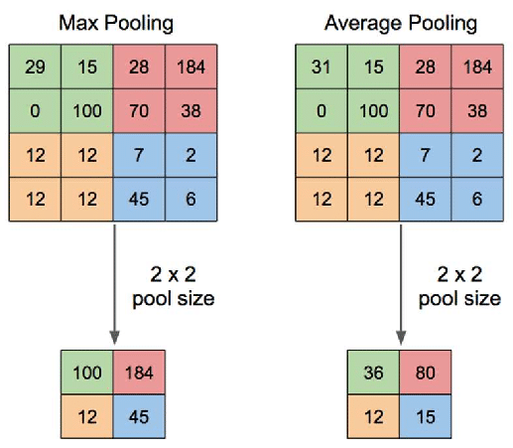
CNN
Pooling layer is for anti-noise.
Max pooling
Average pooling
Ref: https://www.researchgate.net/figure/Illustration-of-Max-Pooling-and-Average-Pooling-Figure-2-above-shows-an-example-of-max_fig2_333593451

Slide 19
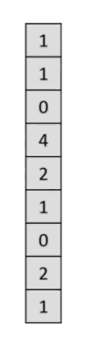
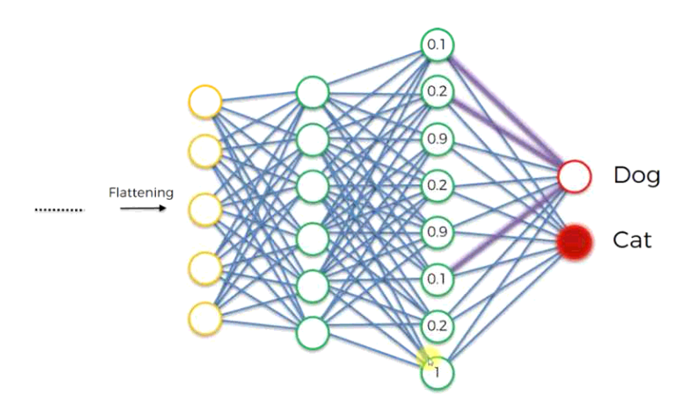
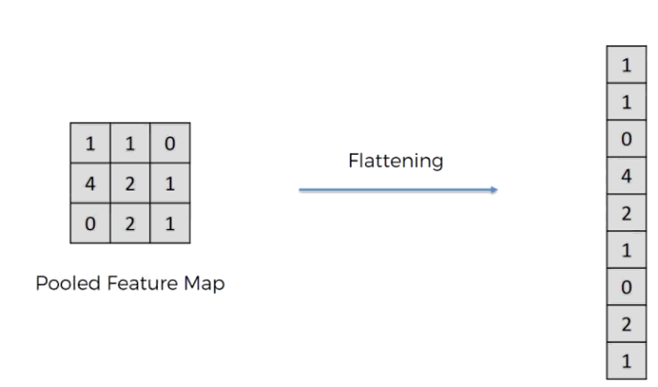
CNN
The fully connected layer is to flatten the previous results and then connect to the most basic neural network.
Flattening
Ref: https://medium.com/jameslearningnote/%E8%B3%87%E6%96%99%E5%88%86%E6%9E%90-%E6%A9%9F%E5%99%A8%E5%AD%B8%E7%BF%92-%E7%AC%AC5-1%E8%AC%9B-%E5%8D%B7%E7
%A9%8D%E7%A5%9E%E7%B6%93%E7%B6%B2%E7%B5%A1%E4%BB%8B%E7%B4%B9-convolutional-neural-network-4f8249d65d4f

Slide 20
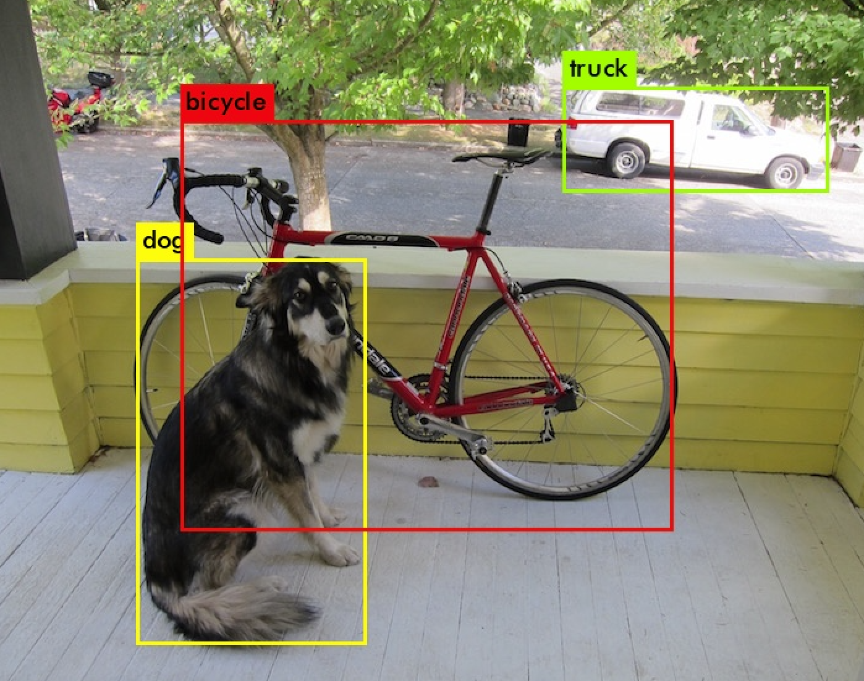
DNN
Deep Neural network is widely used in image recognition
YOLO: Object detection
Classifier: Photo classification
Dog
Classifier
Frog
Cat
YOLO
Classifier
Ref: https://pjreddie.com/darknet/yolo/

Slide 21
How to train a classifier
What does train mean ?
Obtain the parameters that is suitable for the classes you want to classify
5.6
2.6
-0.6
0
-2.6
3.1
2
6.6
3.1
-0.6
-1.1
-9.2
7.6
-1.8
-0.2
3.6
1.9
-0.2
2.1
1.1
3.2
0.9
1.1
3.2
5.9
1.1
3.2
Bias: 0.7
Bias: -0.1
Bias: 3.1
Which one is the best ?

Slide 22
How to train a classifier
How to train a DNN model?
1. Prepare enough data
2. Build the Model
3. Define Error Measurement for Ein Evaluation
4. Use an algorithm to find the best parameters to reduce Ein
5. Finally, evaluate whether there is Overfitting and make sure that Ein ≈ Eout

Slide 23




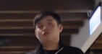

How to train a classifier
Prepare enough data
F
R
B
L
F
L

Slide 24
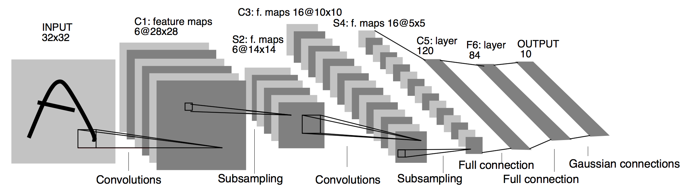
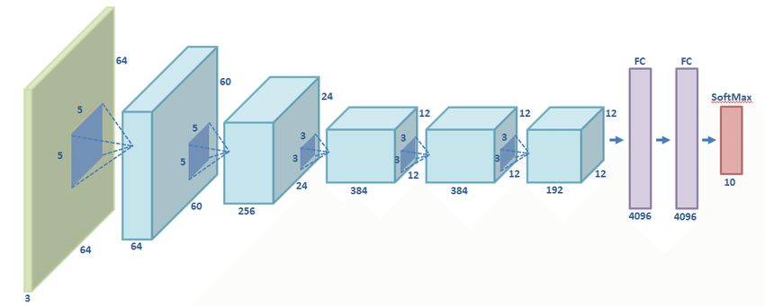
How to train a classifier
Build the Model
Alexnet
Lenet5
Ref: https://www.researchgate.net/figure/Scheme-of-the-AlexNet-network-used_fig1_320052364
https://medium.com/@pechyonkin/key-deep-learning-architectures-lenet-5-6fc3c59e6f4

Slide 25
How to train a classifier
Build the Model
Input
32 x 32
Conv
32, 5x5
Conv
64, 5x5
Dense
64
Conv
32, 5x5
Relu
Relu
Dense
4
Maxpool
2x2, 2x2
Avgpool
2x2, 2x2
Avgpool
2x2, 2x2
Relu
Cifar10

Slide 26
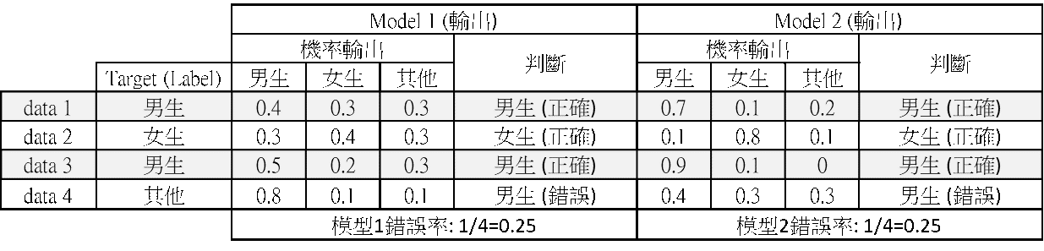
How to train a classifier
Define Error Measurement
Loss function: Used to evaluate the degree of inconsistency between the predicted value of the model and the true value, which is also the objective function of optimization in the neural network
Cross-entropy
A commonly used loss functions for classification problems
Ref: https://chih-sheng-huang821.medium.com/%E6%A9%9F%E5%99%A8-%E6%B7%B1%E5%BA%A6%E5%AD%B8%E7%BF%92-%E5
%9F%BA%E7%A4%8E%E4%BB%8B%E7%B4%B9-%E6%90%8D%E5%A4%B1%E5%87%BD%E6%95%B8-loss-function-2dcac5ebb6cb

Slide 27
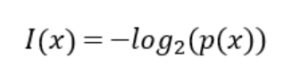
How to train a classifier
Entropy
Entropy is the average amount of information contained in all messages received
information gain
EX: The probability of A passing the exam is 0.4, The probability of B passing the exam is 0.99
Ref: https://chih-sheng-huang821.medium.com/%E6%A9%9F%E5%99%A8-%E6%B7%B1%E5%BA%A6%E5%AD%B8%E7%BF%92-%E5
%9F%BA%E7%A4%8E%E4%BB%8B%E7%B4%B9-%E6%90%8D%E5%A4%B1%E5%87%BD%E6%95%B8-loss-function-2dcac5ebb6cb

Slide 28
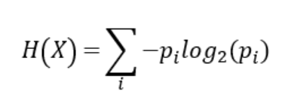
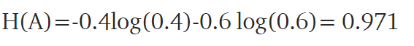
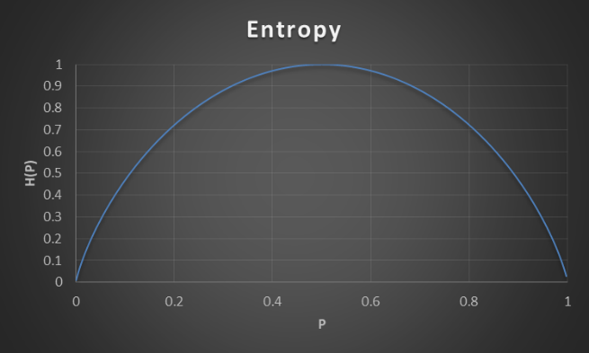
How to train a classifier
Entropy
Ref: https://chih-sheng-huang821.medium.com/%E6%A9%9F%E5%99%A8-%E6%B7%B1%E5%BA%A6%E5%AD%B8%E7%BF%92-%E5
%9F%BA%E7%A4%8E%E4%BB%8B%E7%B4%B9-%E6%90%8D%E5%A4%B1%E5%87%BD%E6%95%B8-loss-function-2dcac5ebb6cb

Slide 29
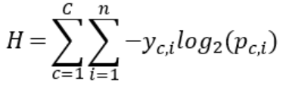
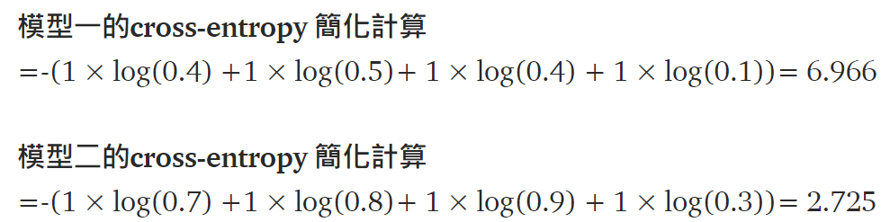
How to train a classifier
Cross Entropy
C: Classes
N: number of data
yc,i: binary indicator (0 or 1) from
one hot encode
pc,i: the predicted probability
that the i-th data belongs to
the c-th category.
Ref: https://chih-sheng-huang821.medium.com/%E6%A9%9F%E5%99%A8-%E6%B7%B1%E5%BA%A6%E5%AD%B8%E7%BF%92-%E5
%9F%BA%E7%A4%8E%E4%BB%8B%E7%B4%B9-%E6%90%8D%E5%A4%B1%E5%87%BD%E6%95%B8-loss-function-2dcac5ebb6cb

Slide 30
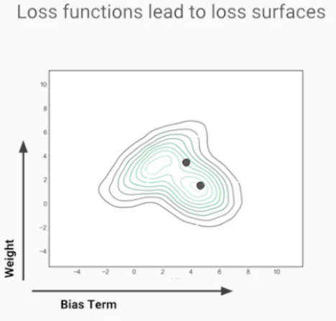
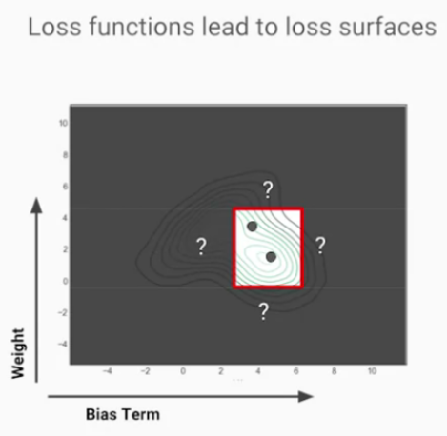
How to train a classifier
Use an algorithm to find the best parameters to reduce Ein. in other words, update parameters
Gradient Descent: a "method to update parameters"
Ref: https://ithelp.ithome.com.tw/articles/10218980

Slide 31
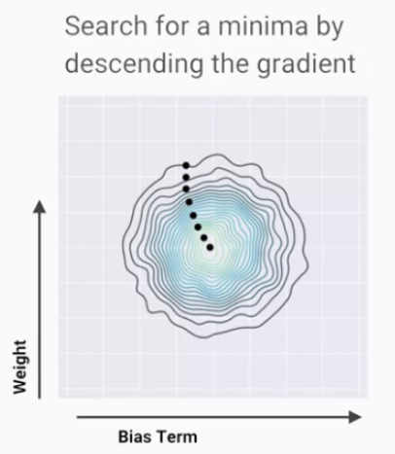
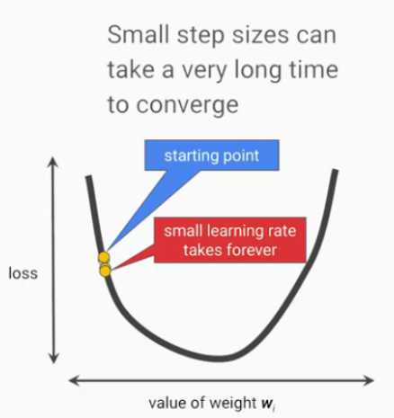
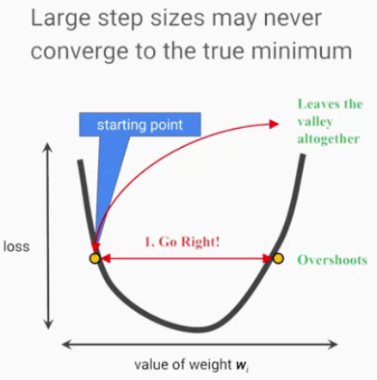
How to train a classifier
Gradient Descent: a "method to update parameters"
Ref: https://ithelp.ithome.com.tw/articles/10218980

Slide 32
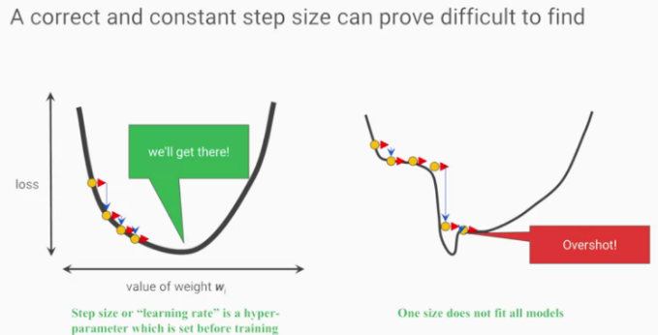
How to train a classifier
Gradient Descent: a "method to update parameters"
Ref: https://ithelp.ithome.com.tw/articles/10218980

Slide 33
How to train a classifier
Optimizer: We know that the Loss function is to help us judge the error value, and the Optimizer is to adjust the parameters to make the Loss as small as possible.
SGD
Momentum
Adagrad
Adam

Slide 34
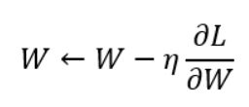
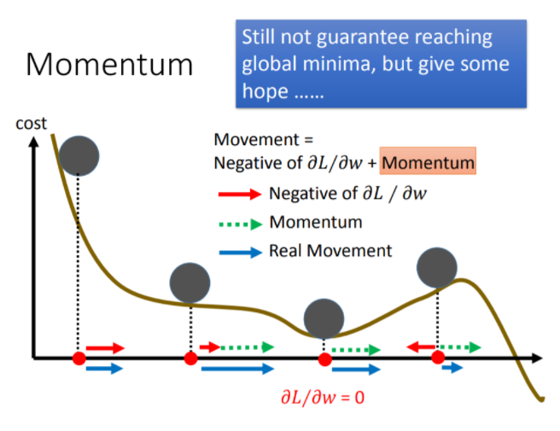
How to train a classifier
SGD: SGD is the simplest gradient decent method
Momentum: This optimizer is the concept of simulating physical momentum.
Ref: https://www.youtube.com/watch?v=xki61j7z-30&list=PLJV_el3uVTsPy9oCRY30oBPNLCo89yu49&index=16&ab_channel=Hung-yiLee

Slide 35
How to train a classifier
Adagrad : The learning rate η of the previous Optimizers are all fixed values, and Adagrad is an optimizer that adjusts the learning rate η according to the gradient.
Adam: Adam Optimizer can actually be said to be a combination of Momentum and Adagrad introduced earlier.

Slide 36
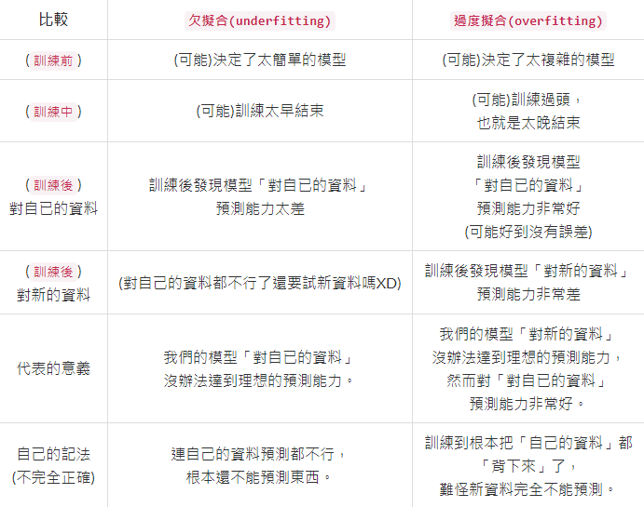
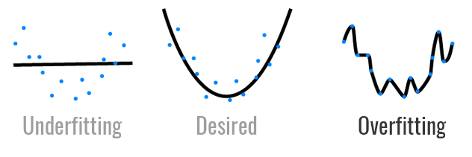
How to train a classifier
Underfitting and overfitting
Ref: https://ithelp.ithome.com.tw/articles/10221245
https://ithelp.ithome.com.tw/articles/10203371

Slide 37
How to train a classifier
How to prevent overfitting?
Data augmentation
Simple model
Dropout
Early Stopping

Slide 38
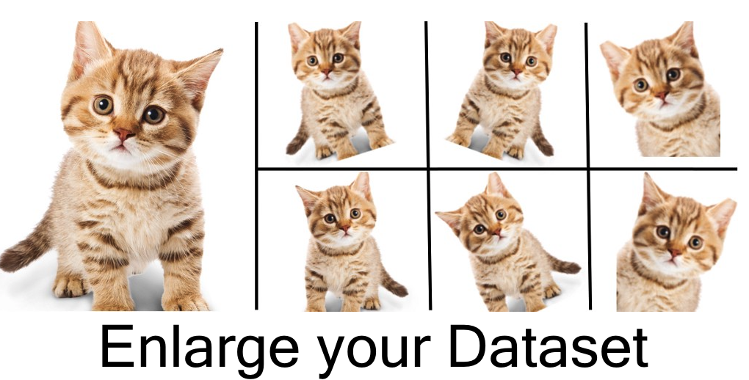
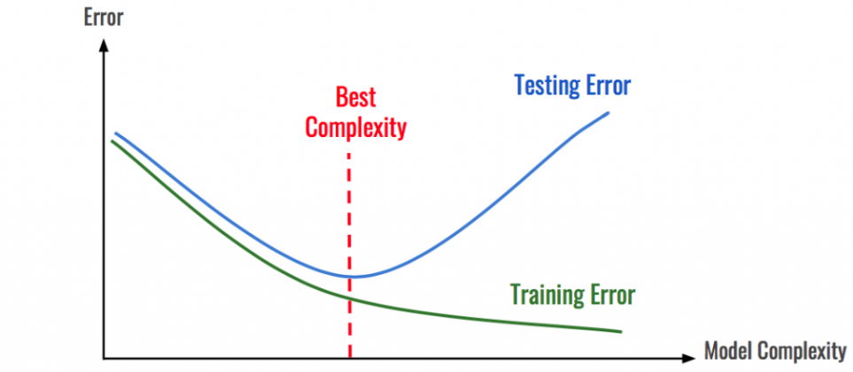
How to train a classifier
Data augmentation
Maybe the Dataset is not diverse enough
Simple model
Maybe the model is too strong
Ref: https://ithelp.ithome.com.tw/articles/10221245
https://ithelp.ithome.com.tw/articles/10203371

Slide 39
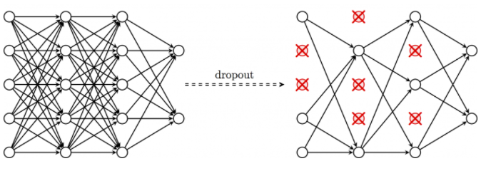
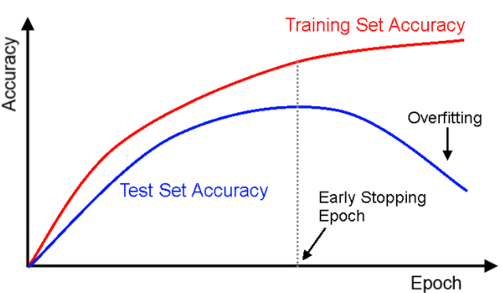
How to train a classifier
Dropout
During training, randomly turn off some neurons
Early Stopping
Stop training when accuracy no longer improves
Ref: https://ithelp.ithome.com.tw/articles/10221245
https://ithelp.ithome.com.tw/articles/10203371

Slide 40
Thanks for your listening!

